Slide 1
Crop Recommendation System
Piyush Pandya-202319023
Viraj Hirpara-202319003

Slide 2

Our Objectives
We want to help farmers by equipping them with data-driven crop recommendations empowers them to make informed decisions, enhancing their agricultural expertise and livelihood.: Crop Recommendation: Crop recommendation based on land parameters is crucial in India due to its diverse agro-climatic zones and varying soil types. By matching crops to land capabilities, farmers can minimize resource wastage, maximizing water use, nutrient management, and overall farm efficiency.
Cost Insights: This analysis aids farmers in making informed decisions, choosing crops that offer higher returns relative to input costs, mitigating financial risks, and optimizing resource allocation. Additionally, it enables strategic planning, ensuring sustainable agricultural practices and better economic outcomes for farmers across different regions in India.

Slide 3


Crop recommendation
Cost prediction
Functionalities
Based on the provided farm information encompassing soil type and pH range, a tailored selection of recommended crops will be presented to the farmer. The farmer will have the opportunity to choose from a curated list of crops suitable for the specified soil type and pH range
Upon the farmer's crop selection, comprehensive cost details specific to that chosen crop per acre and for the designated area will be provided. This provision aims to facilitate the farmer in conducting thorough financial planning and aids in the decision-making process pertaining to the cultivation of the selected crop.

Slide 4
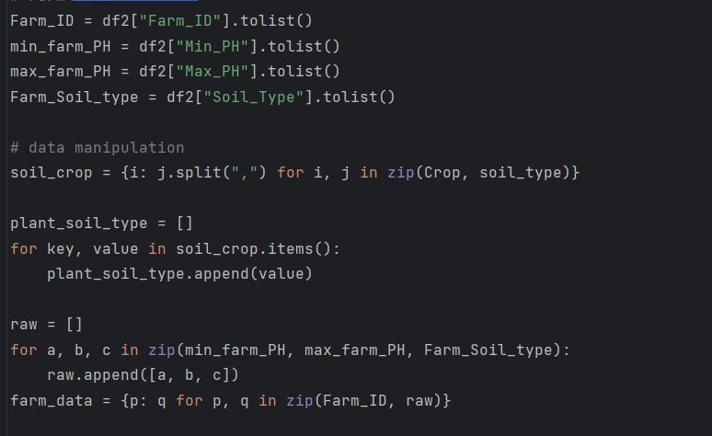
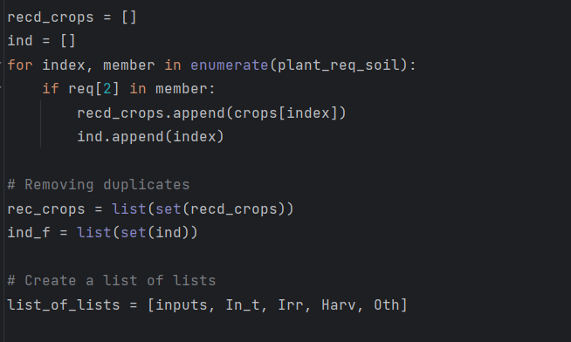
Functionalities: Crop Recommendation
Code Snippets of above mentioned functionalities are below:

Slide 5
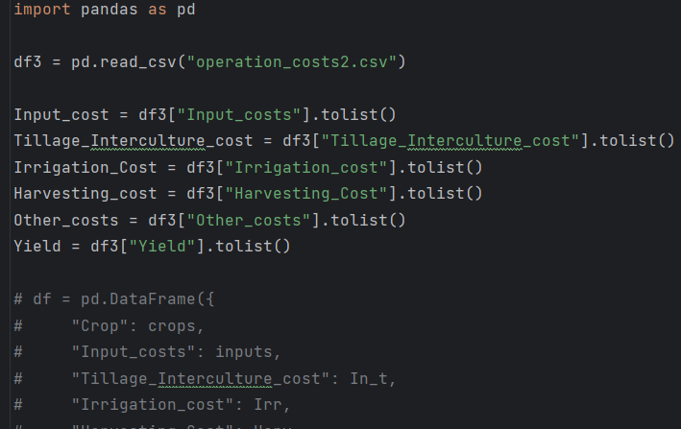
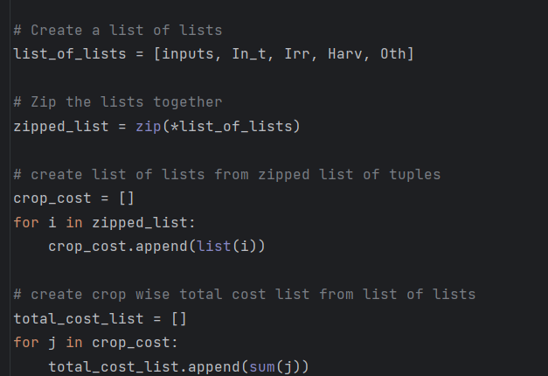
Functionalities: Cost Prediction
Code Snippets of above mentioned functionalities are below:

Slide 6
Topics from the course covered in the project
List
Loops
Dictionary
Functions
Tuples
Combining Data Structure and Modules
Conditions

Slide 7
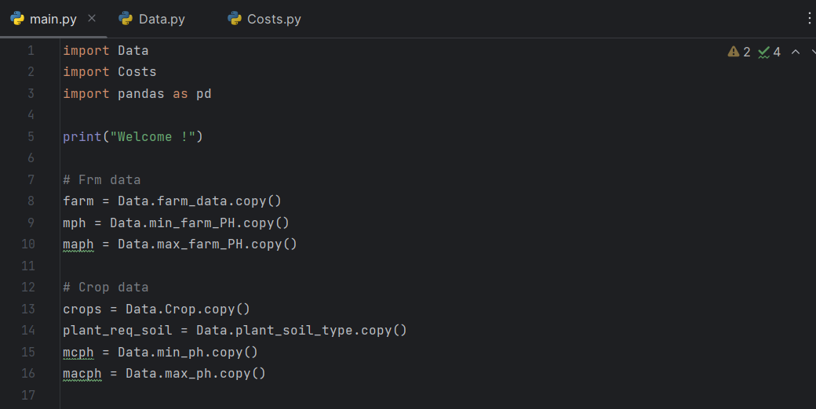
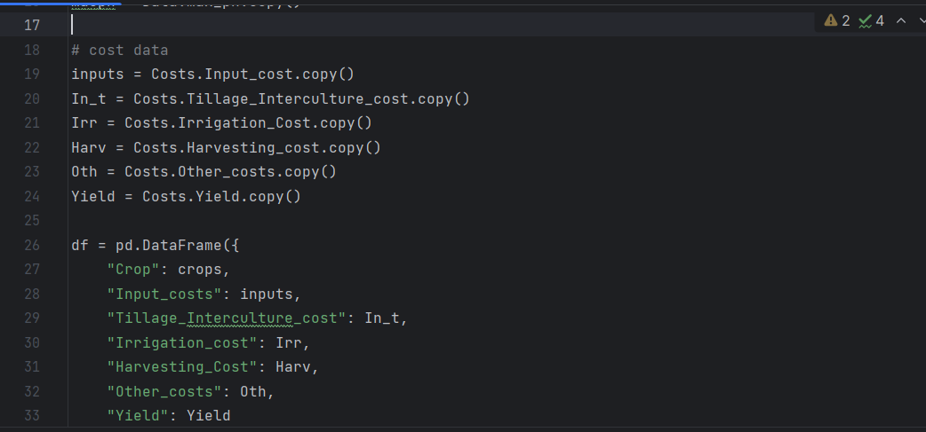
Code Snippets

Slide 8
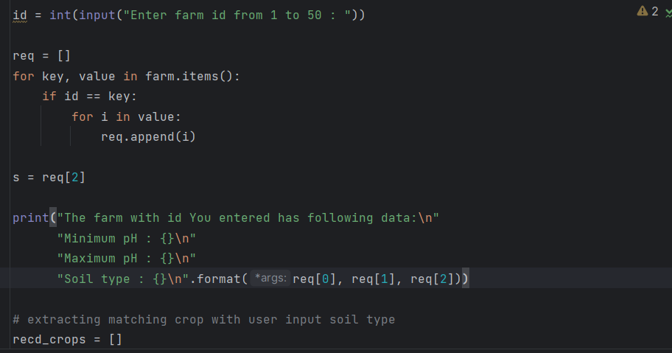
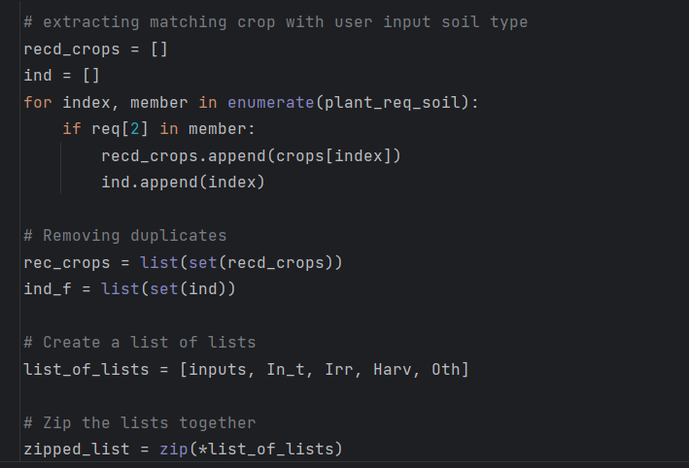
Code Snippets

Slide 9
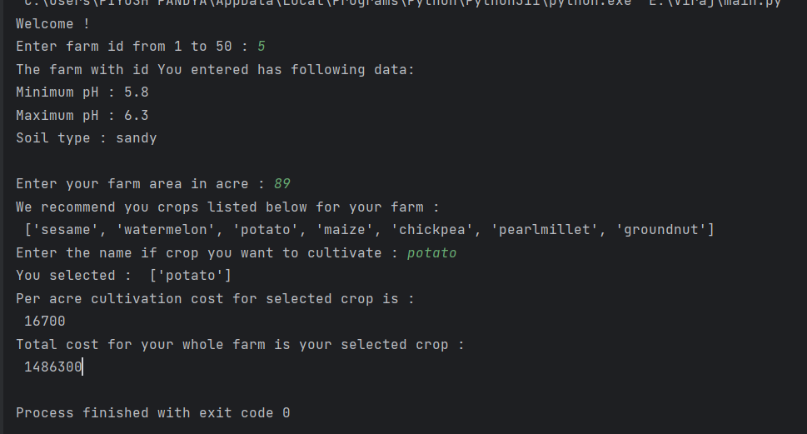
Output with Snippets

Slide 10
Future Work
Enhanced Crop Recommendations: Recommendation system can be expanded to consider additional factors such as climate data, historical yield records, pest prevalence, and market demand.
Integration of Machine learning and AI: Incorporation of technologies like machine learning or artificial intelligence algorithms to continuously refine crop recommendations based on real-time data inputs, thereby improving the system's adaptability and precision.
Mobile Application Development: Development of a user-friendly mobile application that allows farmers to access crop recommendations, cost analysis, and other agricultural resources easily.
Data Expansion and Collaboration: Collaboration with agricultural research institutions, government bodies, and local agronomists to collect more extensive and detailed data on soil health, crop performance, and cost variations across different regions, to improve the accuracy and applicability of the system.

Slide 11
Future Work
Financial Forecasting Tools: Integration of financial forecasting tools or predictive models to estimate future crop prices, input costs, and potential profits. This would assist farmers in long-term planning and decision-making.
User Feedback: Implementation of a feedback mechanism within the system to collect input from farmers regarding the accuracy and usefulness of recommendations. This feedback can be used to continually refine and improve the recommendation and cost analysis algorithms.
Education and Support: Providing educational resources and support materials within the application or platform to educate farmers on sustainable farming practices, efficient resource utilization, and modern agricultural techniques.
By implementing these enhancements, the project can evolve into a more robust and user-friendly tool, empowering farmers with accurate, timely, and actionable insights for informed decision-making in agriculture.

Slide 12
Conclusion
In summary, this project aimed to provide farmers with a systematic approach to crop selection and cost analysis based on their farm's soil parameters.
This tool serves as a valuable resource for financial planning and decision-making, enabling farmers to optimize their crop selection based on profitability and resource efficiency.
Continued refinement and incorporation of additional factors could further enhance the accuracy and usefulness of this system, contributing to the sustainable growth of agricultural practices in India.

Slide 13
Thank You!

